Slide 1
ESG-CV Implementation – Pasco County Program Design - Coordinated Investment Plan
NCDA 2021 Annual Conference
Marcy Esbjerg, MPA
Director
Pasco County, FL
mesbjerg@pascocountyfl.net

Slide 2
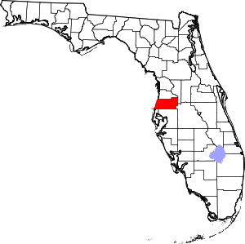
Pasco County
Population – 553,000 (just under 200,000 households)
Location – north of Tampa, FL on the Gulf of Mexico
Square Miles – 747
Owner-occupied/rental housing – 72%/28%
LMI – 40% LMI, 54% Cost Burdened
CDBG - $2.9 million
HOME - $1.2 million
ESG - $234,000
CDBG-CV 1st Tranche - $1.7 million
ESG-CV – 1st Tranche - $834,000
ESG- CV – 2nd Tranche - $3.8 million
CDBG-CV – 3rd Tranche - $1.996 million

Slide 3
About Pasco County, FL Continuum of Care
One CoC encompasses the entire geographic area of the County
Lead agency and HMIS Lead – Homeless Coalition of Pasco County
Direct ESG Recipient – Pasco County Community Development
CoC Chair – Marcy Esbjerg, Director of Community Development

Slide 4
What we know about homelessness in Pasco County?
Point in Time Count 2021
Unsheltered: 523
Sheltered: 334
Single Adult Households 2021
Unsheltered: 409
Sheltered: 172
Family Households 2021
Unsheltered: 6
Sheltered: 36
With unprecedented funding amounts for homelessness, how can we be more strategic in our planning to make a visible difference in our community? The most effective way to prevent, prepare or respond to COVID-19 is to safely and permanently house those who experience homelessness.

Slide 5
Coordinated Investment Plan – Technical Assistance from Florida Housing Coalition
What are the resources available
to fund the re-housing strategy?
Set local re-housing goals based on the needs
of people experiencing homelessness
Permanent housing interventions (type and amounts of assistance) based on people’s needs to exit or avoid homelessness.
Use resources and goals
to allocate across funding sources to safely re-house those experiencing homelessness during the pandemic.

Slide 6
Steps in Process
Convene
Convene local planning group
Determine
Determine local goals
Define
Define cohorts and determine cohort-specific housing interventions
Determine
Determine intervention project types and descriptions
Estimate
Estimate number of households in each cohort
Estimate
Estimate project component costs
Inventory
Inventory all available resources
Determine
Determine how those resources will be deployed to fund projects and meet goals
Notes:
Local planning group – subcommittee of the Coc
Goals/Cohorts
Intervention – motel stays, RRH, PSH
Estimate – via PIT
Costs and Resources
Identify all funding sources – both specific to homelessness, COVID, Community Development and Affordable Housing
Understand the importance of budgeting and targeting the increased funding rather than spending haphazardly
Funding should not be considered agency funding but part of the Coordinated Investment Plan

Slide 7
Cohorts – Rehousing 225 households
Cohorts – Prevention
100 households
80 Unsheltered who are elderly, disabled, or long-term homeless but not chronically homeless
80 Unsheltered who are not elderly, disabled, or long-term homeless
30 Unsheltered who are chronically homeless according to HUD definition
35 Homeless families
40 Homeless families with minimal needs and/or natural supports
60 Homeless families with higher needs
Determinations influenced by:
Significant unsheltered population due to minimal emergency shelter beds + high barrier shelters
Significant single adult male unsheltered population
Review of the numbers of our last Point-in-Time Count
On-going issues with unsheltered homeless at certain hotspots, with law enforcement, concerns of elected officials in the County

Slide 8
Overview of Anticipated Costs
Anticipated costs to provide housing to 225 households and prevent 100 households from becoming homeless - $3.8 million
Includes cost of outreach, case management and housing
Utilizing CRF for motels and move-in expenses, ESG-CV, HOME TBRA, State ESG-CV, regular ESG, CoC grants for rental assistance

Slide 9
Overview of System and Workflow
Pasco County Continuum of Care – HUD Region FL-519 – to make homelessness in Pasco County – rare, brief and non-recurring. Leadership Council – 21 members from all sectors – government, health, social services, law enforcement, school, courts and more.
Coalition for the Homeless of Pasco County – Lead Agency, Fiscal Agent
Prevention – with diversion and short term rental assistance 100 households will maintain housing – Local agencies
Emergency Housing – Motels, Case Management – Local agencies
30 CH households Permanent Supportive Housing, housing search, Local Agencies, Case Management
Outreach & Identification – Local agencies
195 households Rapid Rehousing, housing search
Local agencies
Case management

Slide 10
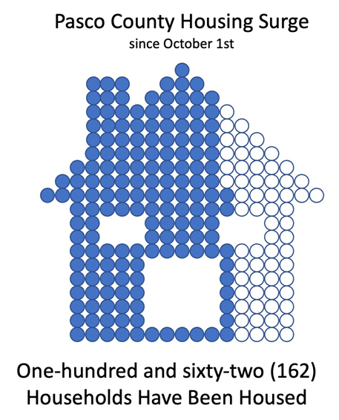
Lessons Learned
If you fail to plan, you plan to fail.
It all comes down to capacity; engage one or more agencies.
Be careful of using motels for temporary stays.
Expect the unexpected. Housing market vacancies collapsed, leaving little opportunities for leasing.
Follow your subrecipient agreement.

Slide 11
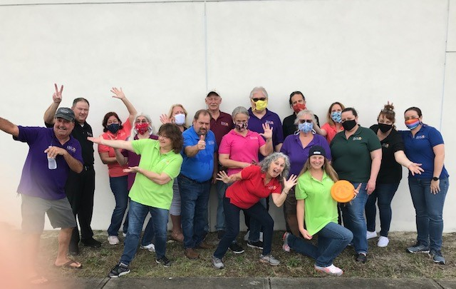
Questions?
Mission
Improving the lives of Pasco’s citizens through homeless initiatives, neighborhood revitalization, affordable housing and community partnerships using state and federal funding.
Notes:
XXX17-XXXX P1 Slide 3 of 4 Kim Styles

